Slide 1

Novelty Search in Evolutionary Computations
Arshiya Khan
CCRG
UD

Slide 2
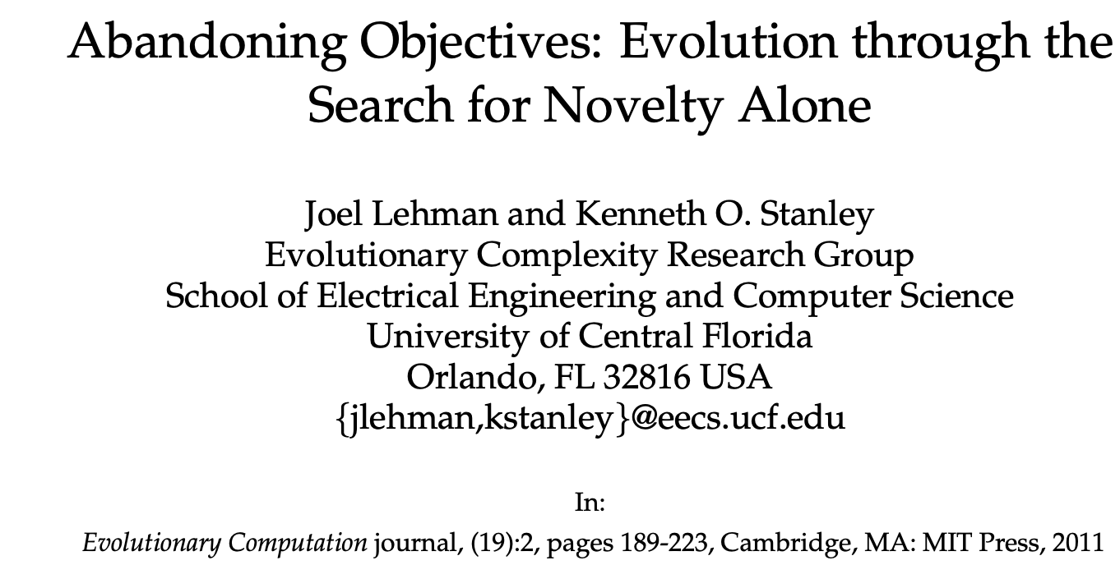

Slide 3
Evolutionary computation
Computational intelligence technique inspired from natural evolution
Process of natural evolution is used as a role model for a strategy for finding optimal or near optimal solutions for a given problem
Examples: Ant colony optimization, Swarm intelligence
Genetic algorithms

Slide 4
Genetic algorithm
High-quality solutions to optimization and search problems by relying on biologically inspired operators
Initial Population: a genetic representation of the solution domain
Fitness Function: Determines how fit an individual is (the ability of an individual to compete with other individuals)
Selection: A pair of two individuals (parents) are selected based on their fitness scores
Crossover: Offspring are created by exchanging the genes of parents among themselves until the crossover point is reached.
Mutation: In certain new offspring formed, some of their genes can be subjected to a mutation with a low random probability.
Termination: The algorithm terminates if the population has converged (does not produce offspring which are significantly different from the previous generation)

Slide 5
Population
Fitness objective
Fitness score
Selecting the Parents
bahama
abcdef
ijklmn
…………
mnopqr
stuvwx
cabana
banyan, 5
abcdef, 2 #(2 characters are present in this word)
ijklmn, 1
mnopqr, 1
stuvwx, 0
cabana, 5
banyan, 5
cabana, 5
banana
Making a Crossover
Making a Mutation
Convergence
canyan
cabyan
cabyna
babyna
banana
yanbac
All other possible combinations from the parent words ‘banyan’ and ‘cabana’
banyan
yanbac
nnbaaa, 6
aaabnn, 6
aabann, 6
abaann, 6
banana, 6
baaann, 6
→ yanyan,4
yanbac → canbay,4
banyan → nanyab,5
abbynb
cabayn
→ aabann,6

Slide 6
Objective function
The fitness function normally measures progress towards an objective in the search space
Similarity to ANN:
Reward moving closer to goal
Pathology of local optima (dead end)
Increasing fitness does not always reveal the best path through the search space

Slide 7
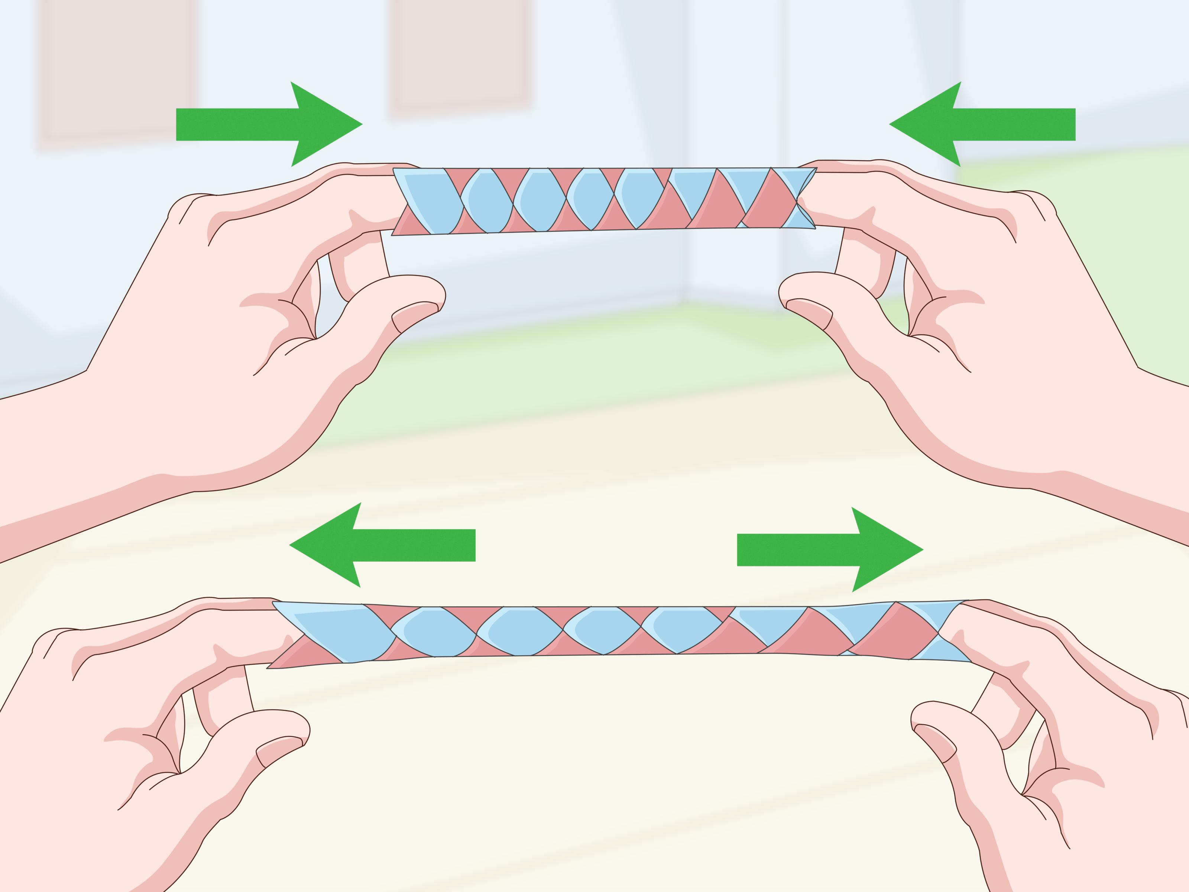
Deception
Chinese finger trap problem
Goal: Free one’s fingers
Rewarding solution: Pulling them apart
Actual solution: Push one’s fingers together, which seems to entrap them more severely
A problem is deceptive if lower-order building blocks, when combined, do not lead to a global optimum

Slide 8
Non-objective Search
Some objectives may be unreachable by direct objective-based search alone
Systems without explicit objectives
Mimic the unbounded innovation of natural evolution
Open ended evolution
Novelty Search: continually finding novel behaviors in the search space

Slide 9
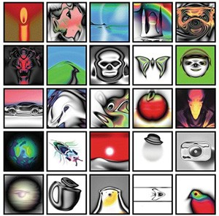
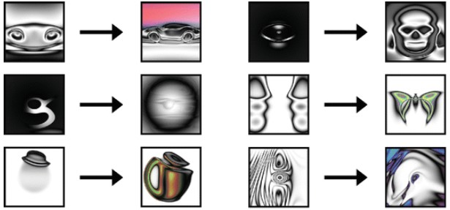
http://picbreeder.org/

Slide 10
NEAT
NeuroEvolution of Augmenting Topologies
Objective based algorithm
Evolve ANNs to solve difficult control and sequential decision tasks
Evolution with a population of small, simple networks and complexifies the network topology into diverse species over generations

Slide 11
NEAT using novelty search
Learning method is rewarded for finding any instance whose functionality is significantly different from what has been discovered before
Novelty metric: In a space of unique behaviors, how far the new individual is from its predecessor. Example: k-nearest neighbor
Behavior space

Slide 12
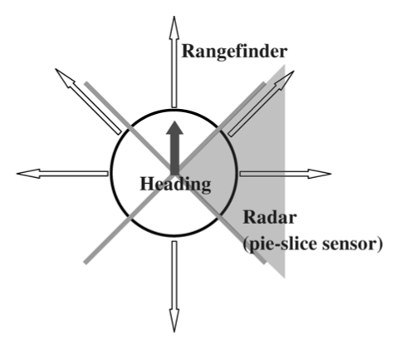
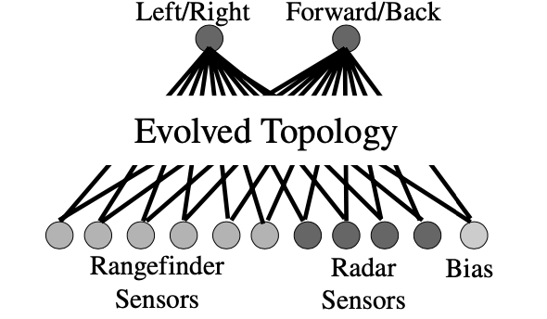
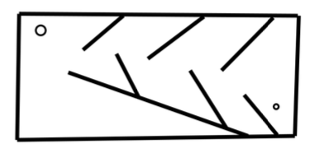
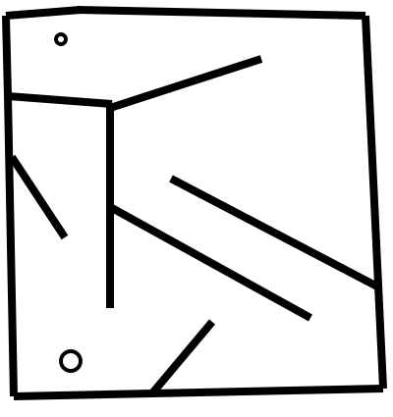
Maze experiment
Suitable deceptive landscape
Actor: A maze navigating robot controlled by an ANN
Fitness function: How close the maze navigator is to the end point
Deception: dead ends that lead close to the end point
Goal: Searching for an ANN that itself can navigate the maze
ANN
Navigator
Medium map
Hard map

Slide 13
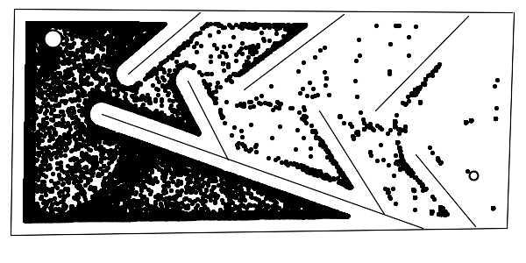
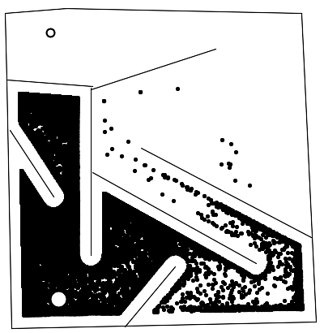
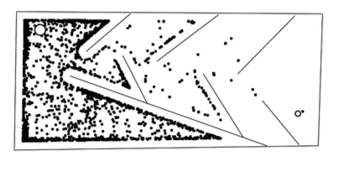
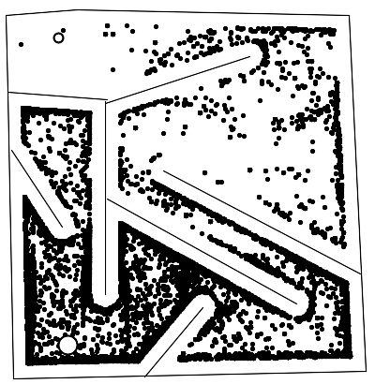
Fitness-based
Novelty-based
Fitness function: distance from the robot to the goal
With no deceptive obstacles, this fitness function defines a monotonic gradient for search to follow
Novelty metric rewards the robot for ending in a place where none have ended before
Method of traversal is ignored
No knowledge of the final goal
stop
stop
start
start
start
start
stop
stop
No of runs | 40/40 | 3/40 | 40/40 | 39/40
No of steps | 56, 334 | - | 18, 274 | 35, 109
Dots = navigator end locations

Slide 14
Questions??

